Slide 1

Project Management: Achieving Competitive Advantage
Fifth Edition
Chapter 13
Project Evaluation and Control
Copyright © 2019, 2016, 2013 Pearson Education, Inc. All Rights Reserved
Notes:
If this PowerPoint presentation contains mathematical equations, you may need to check that your computer has the following installed:
1) MathType Plugin
2) Math Player (free versions available)
3) NVDA Reader (free versions available)

Slide 2
Control Cycles—General Model
Setting a goal.
Measuring progress.
Comparing actual with planned performance.
Taking action.

Slide 3
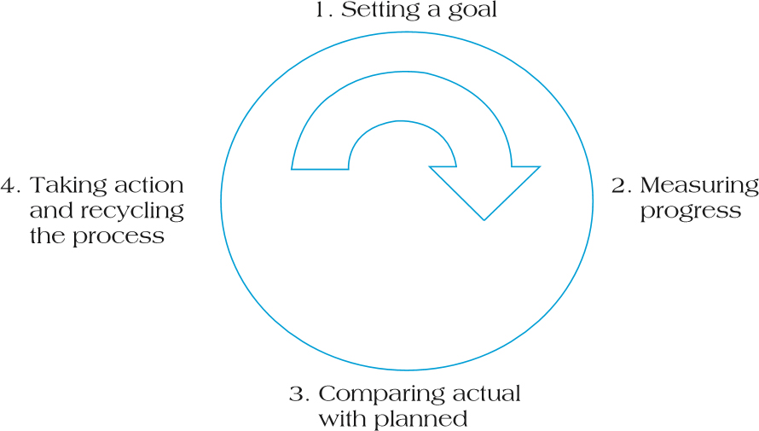
Figure 13.2 The Project Control Cycle

Slide 4
S curve
A tool that allows the progress of a project to be tracked visually over time, and form a historical record of what has happened to date.
It allows project managers to quickly identify project growth, slippage and potential problems that could adversely impact the project if no remedial action is taken.

Slide 5
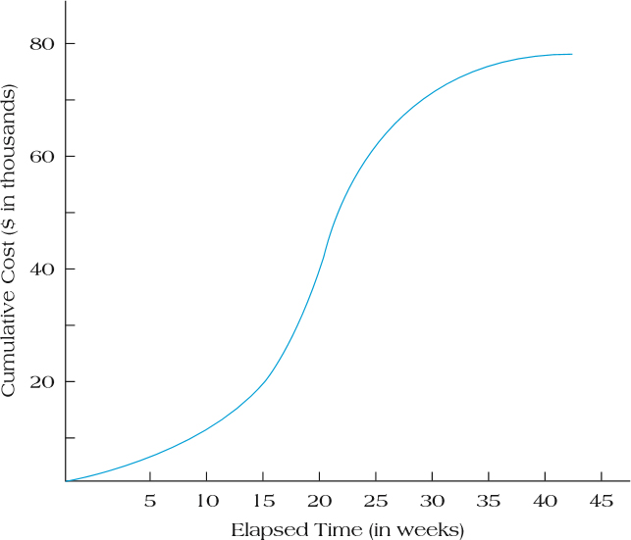
Figure 13.3 Project S-Curves

Slide 6
Milestone Analysis
Milestones are events or stages of the project that represent a significant accomplishment.
Milestones:
Signal completion of important steps
Motivate team and suppliers
Offer reevaluation points
Help coordinate schedules
Identify key review gates
Signal other team members when their participation begins
Delineate work packages

Slide 7
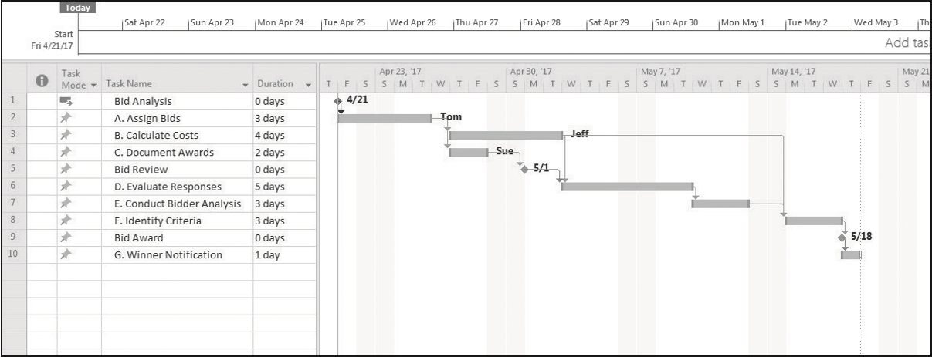
Figure 13.5 Gantt Chart with Milestones

Slide 8
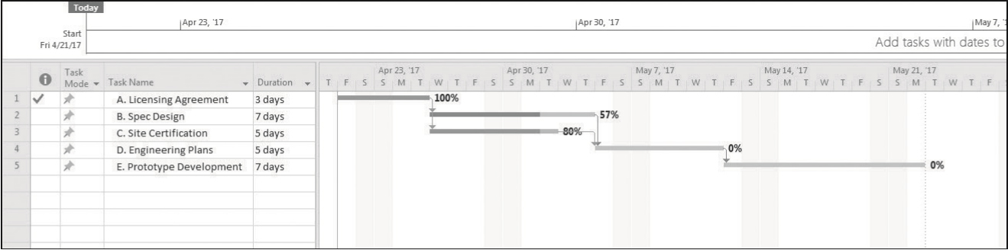
Figure 13.6 Assessing Project Blue’s Status Using Tracking Gantt Chart

Slide 9
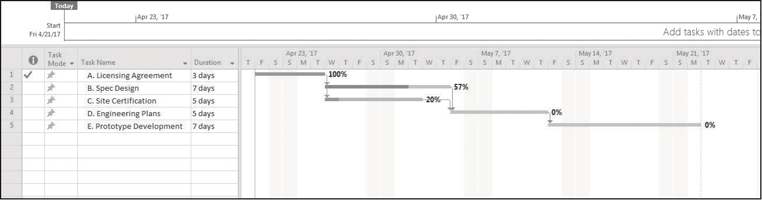
Figure 13.7 Tracking Gantt with Project Activity Deviation
Project status is updated by linking task completion to the schedule baseline.

Slide 10
Earned Value Management
Earned Value Management (E V M) recognizes that it is necessary to jointly consider the impact of time, cost, and project performance on any analysis of current project status.
Earned Value (E V) directly links all three primary project success metrics (cost, schedule, and performance).

Slide 11
Human Factors in Project Evaluation and Control
Project coordination and relations among stakeholders
Adequacy of project structure and control
Project uniqueness, importance, and public exposure
Success criteria salience and consensus
Lack of budgetary pressure
Avoidance of initial overoptimism and conceptual difficulties

Slide 12
Critical Success Factors in the Project Implementation Profile
Project mission
Top management support
Project plans and schedules
Client consultation
Personnel
Technical tasks
Client acceptance
Monitoring and feedback
Communication channels
Troubleshooting

Slide 13
Thank You

